Slide 1
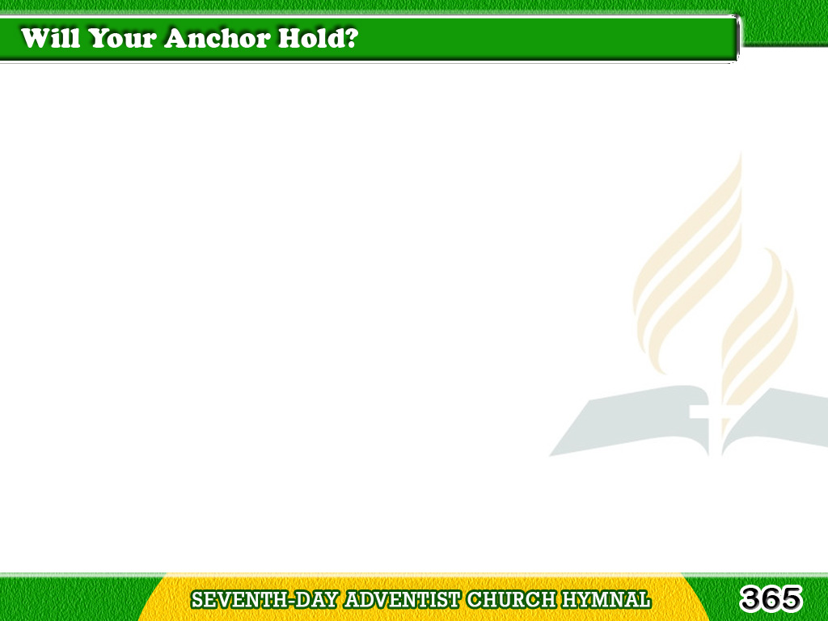
1/5
Will your anchor
hold in the storm of life,
When the clouds unfold
their wings of strife?
Tagalog
Version

Slide 2
1/5
When the strong tides lift,
and the cables strain,
Will your anchor drift,
or firm remain?
Tagalog
Version

Slide 3
1/5
Chorus
We have an anchor
that keeps the soul
Steadfast and sure
while the billows roll;
Tagalog
Version

Slide 4
1/5
Chorus
Fastened to the Rock
which cannot move,
Grounded firm and deep
in the Savior’s love.
Tagalog
Version

Slide 5
2/5
If ‘tis safely moored,
‘twill the storm withstand,
For ‘tis well secured
by the Savior’s hand;
Tagalog
Version

Slide 6
2/5
And the cables,
passed from His heart to thine,
Can defy the blast,
through strength divine.
Tagalog
Version

Slide 7
2/5
Chorus
We have an anchor
that keeps the soul
Steadfast and sure
while the billows roll;
Tagalog
Version

Slide 8
2/5
Chorus
Fastened to the Rock
which cannot move,
Grounded firm and deep
in the Savior’s love.
Tagalog
Version

Slide 9
3/5
It will firmly hold
in the straits of Fear,
When the breakers tell
that the reef is near;
Tagalog
Version

Slide 10
3/5
Though the tempest rave
and the wild winds blow,
Not an angry wave
shall our bark o’er flow.
Tagalog
Version

Slide 11
3/5
Chorus
We have an anchor
that keeps the soul
Steadfast and sure
while the billows roll;
Tagalog
Version

Slide 12
3/5
Chorus
Fastened to the Rock
which cannot move,
Grounded firm and deep
in the Savior’s love.
Tagalog
Version

Slide 13
4/5
It will surely hold
in the floods of death,
When the waters cold
chill our latest breath;
Tagalog
Version

Slide 14
4/5
On the rising tide
it can never fail,
While our hopes abide
within the veil.
Tagalog
Version

Slide 15
4/5
Chorus
We have an anchor
that keeps the soul
Steadfast and sure
while the billows roll;
Tagalog
Version

Slide 16
4/5
Chorus
Fastened to the Rock
which cannot move,
Grounded firm and deep
in the Savior’s love.
Tagalog
Version

Slide 17
5/5
When our eyes behold,
in the dawning light,
Shining gates of pearl,
our harbor bright,
Tagalog
Version

Slide 18
5/5
We shall anchor fast
to the heavenly shore,
With the storms
all past forevermore.
Tagalog
Version

Slide 19
5/5
Chorus
We have an anchor
that keeps the soul
Steadfast and sure
while the billows roll;
Tagalog
Version

Slide 20
5/5
Chorus
Fastened to the Rock
which cannot move,
Grounded firm and deep
in the Savior’s love.
Tagalog
Version

